Slide 1

Prediction of Travel
Insurance Purchase
Group E
PoAn Chen, Susan Wang,
Wenyu Wu, Jing Zhang
ACTUPS 5841
Professor： Yubo Wang
12/9/2021

Slide 2
Agenda
Project Introduction
Data Overview
Variable Selection
Models
Conclusion
Future research
Q&A

Slide 3

Project Introduction
Project Introduction
Data Overview
Variable Selection
Models
Conclusion
Future
Research
1
Travel insurance reimburses policy holders for:
lost baggage
flight delays
medical problems
Real dataset and business problem from a tour & travels company in India

Slide 4
Data Overview
Project Introduction
Data Overview
Variable Selection
Models
Conclusion
Future
Research
2
Total: 1987 observations
Target
Travel Insurance | 1 if the customer purchased travel insurance package in 2019, and 0 otherwise
Age | Age of the customer
Employment Type | The sector in which customer is employed
Graduate Or Not | Whether the customer is college graduate or not
Annual Income | Annual income of the customer in Indian Rupees (rounded to nearest 50 thousand Rupees)
Family Members | Number of members in customer’s family
Chronic Disease | 1 if the customer suffers from major disease or conditions like diabetes, high blood pressures, asthma, etc, and 0 otherwise
Frequent Flyer | Whether the customer booked at least 4 flight tickets in the past two years (2017-2019)
Ever Travelled Abroad | Whether the customer has travelled to a foreign country
Predictors

Slide 5
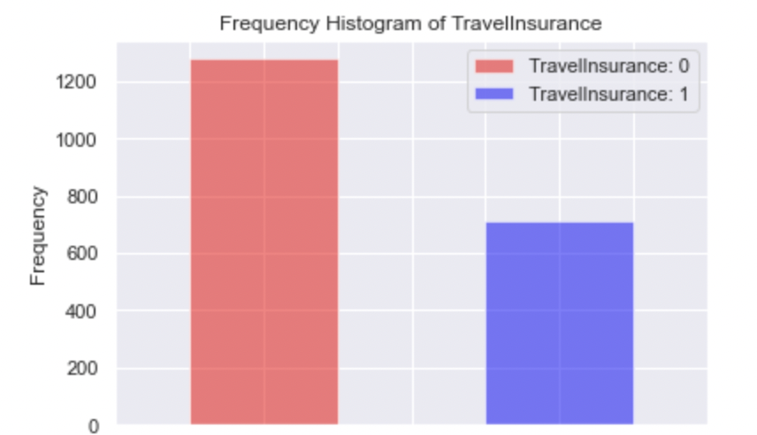
Data Visualization
Project Introduction
Data Overview
Variable Selection
Models
Conclusion
Future
Research
3
Target: Travel Insurance (TI)
Out of 1987 observations
710 (35.7%) purchased TI
1277 (64.3%) did not purchase TI

Slide 6
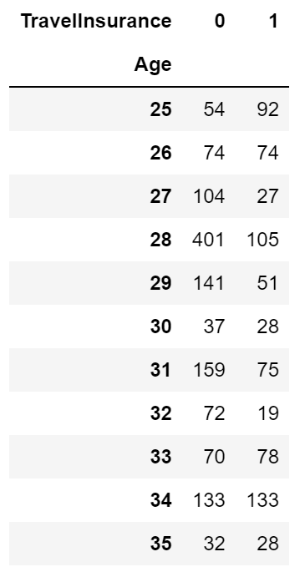
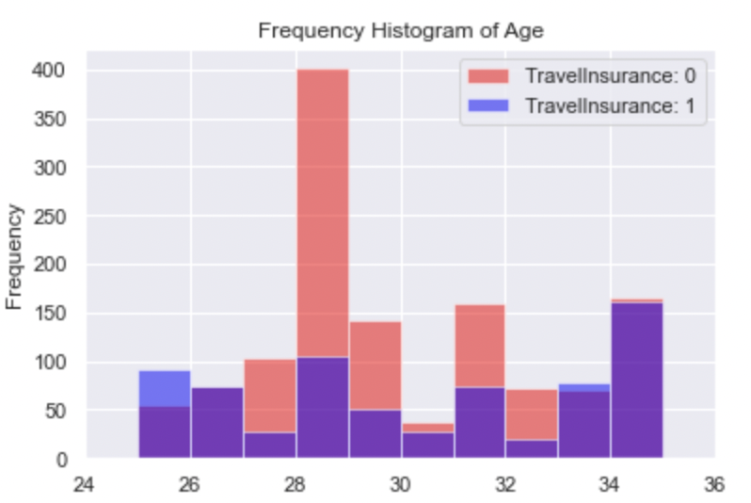
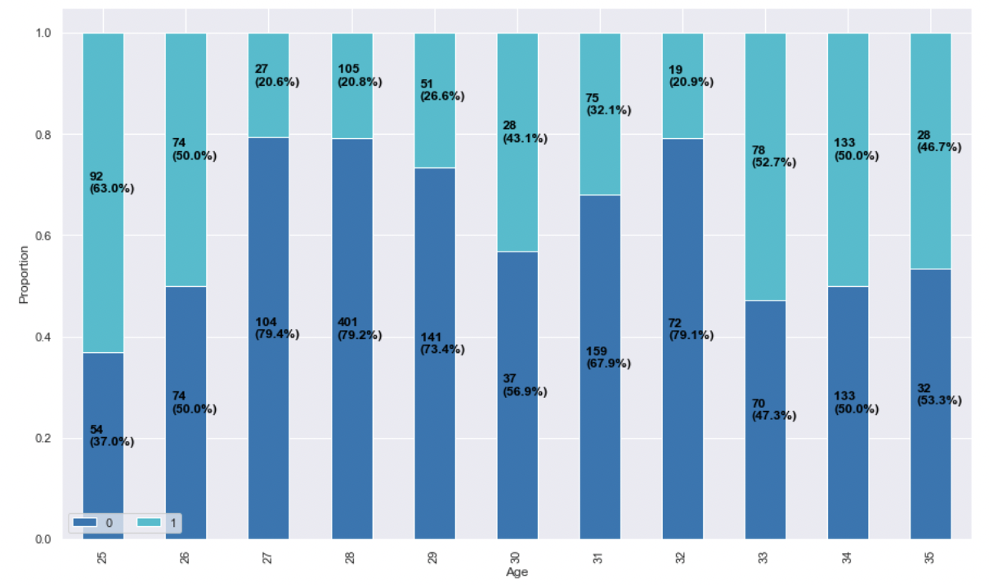
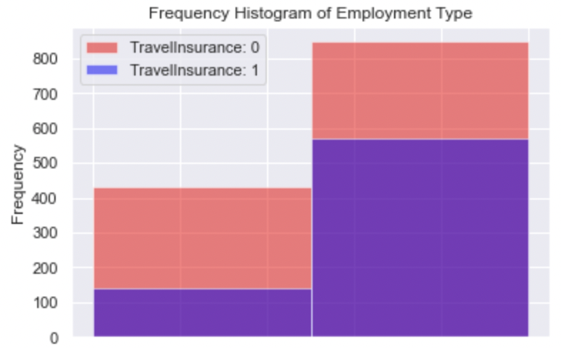
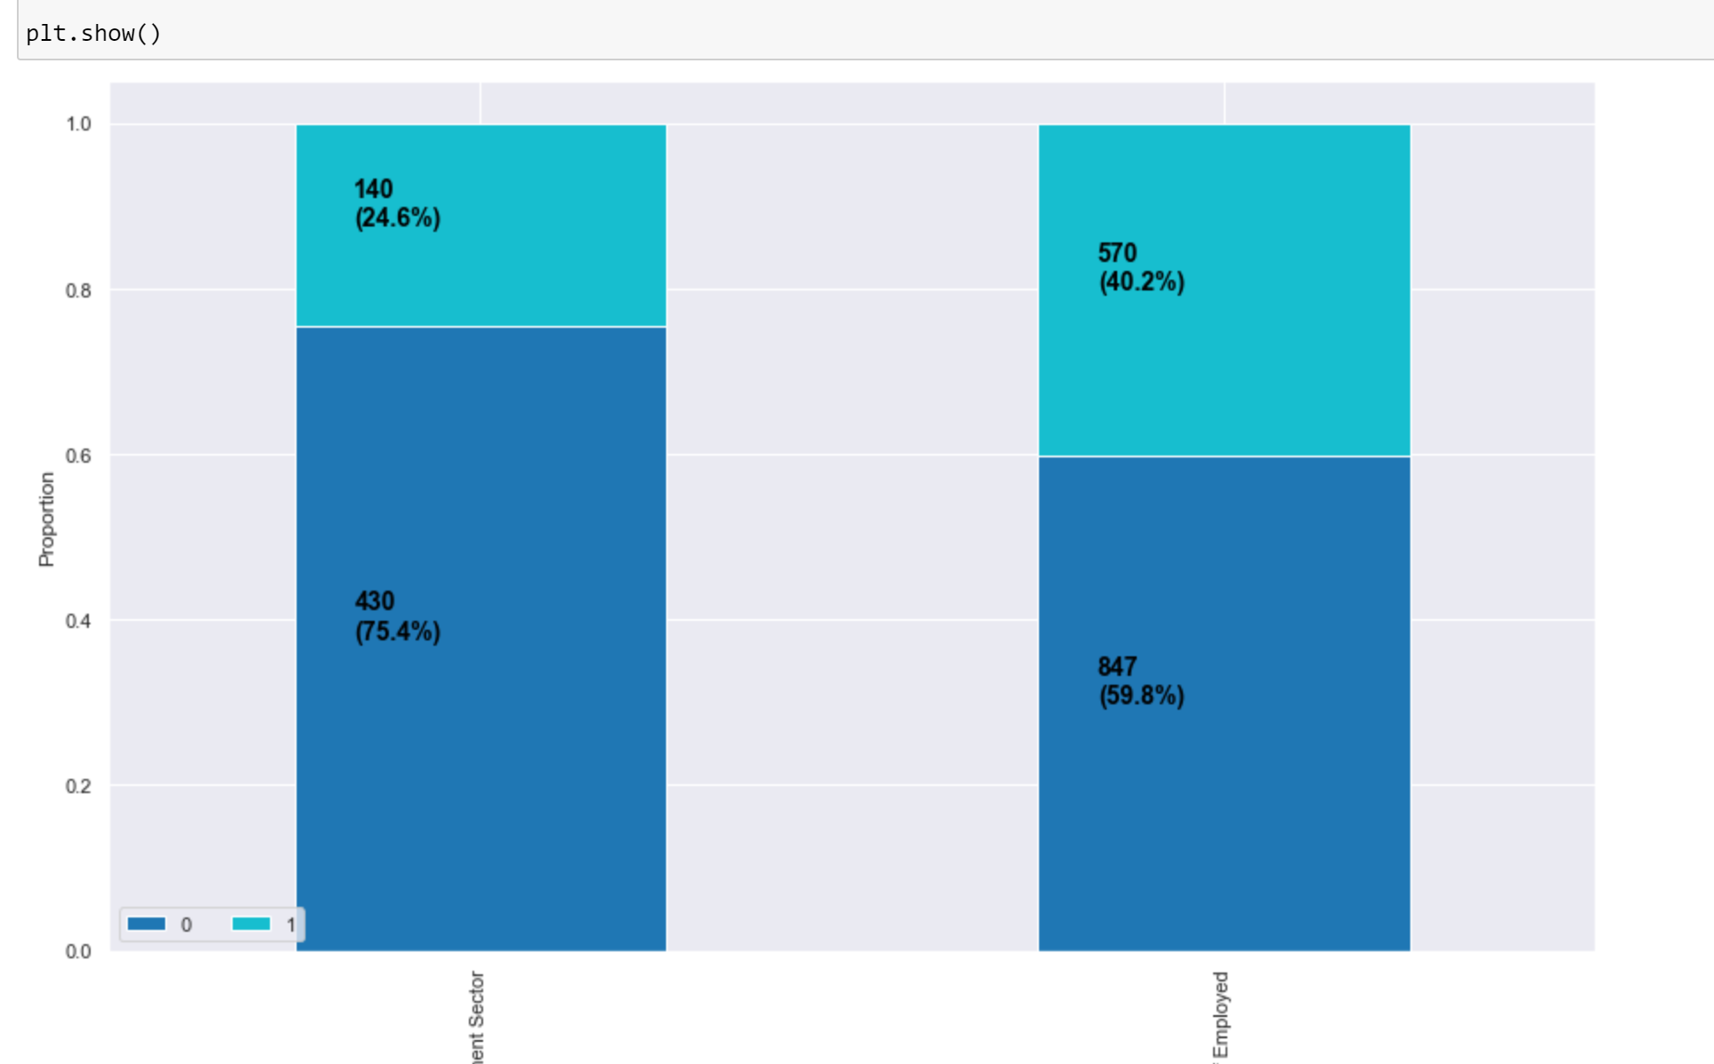
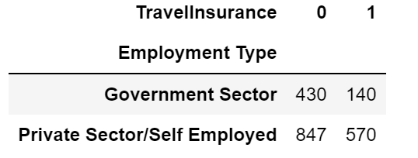
Data Visualization
Project Introduction
Data Overview
Variable Selection
Models
Conclusion
Future
Research
4
Age
Employment Type

Slide 7
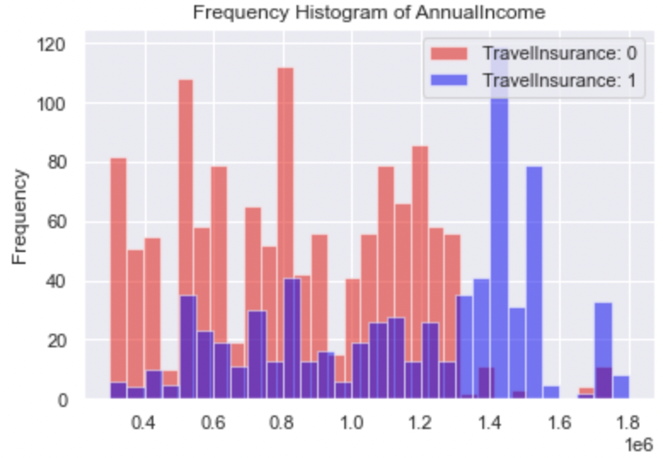
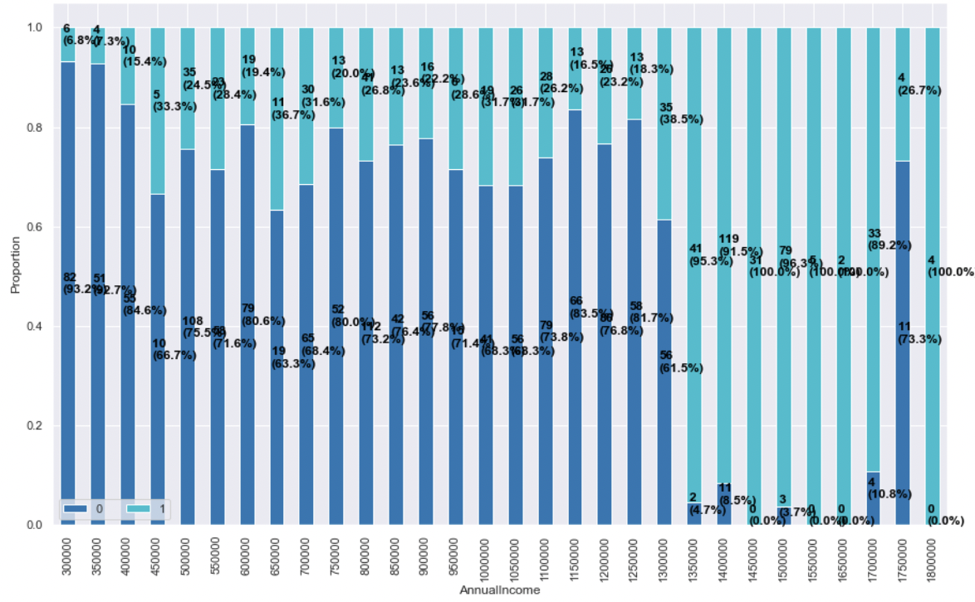
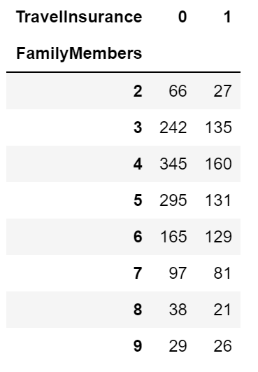
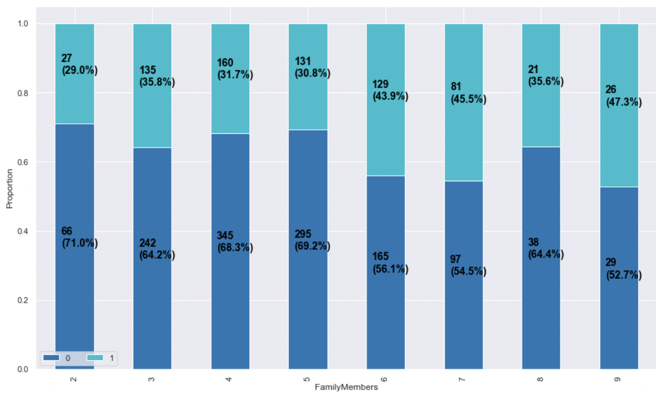
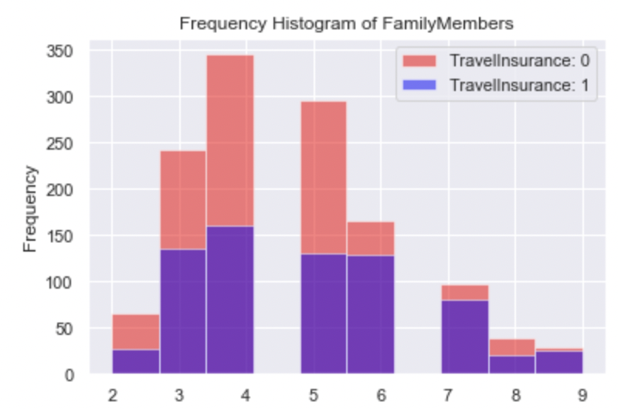
Data Visualization
Project Introduction
Data Overview
Variable Selection
Models
Conclusion
Future
Research
5
Annual Income (in Rupees)
Range:
[300,000, 1,800,000]
Family Members

Slide 8
Agenda
Project Introduction
Data Overview
Variable Selection
Models
Conclusion
Future research
Q&A

Slide 9
Project Introduction
Project Introduction
Data Overview
Variable Selection
Models
Conclusion
Future
Research
1
Travel insurance reimburses policy holders for:
lost baggage
flight delays
medical problems
Real dataset and business problem from a tour & travels company in India

Slide 10
Data Overview
Project Introduction
Data Overview
Variable Selection
Models
Conclusion
Future
Research
2
Total: 1987 observations
Target
Travel Insurance | 1 if the customer purchased travel insurance package in 2019, and 0 otherwise
Age | Age of the customer
Employment Type | The sector in which customer is employed
Graduate Or Not | Whether the customer is college graduate or not
Annual Income | Annual income of the customer in Indian Rupees (rounded to nearest 50 thousand Rupees)
Family Members | Number of members in customer’s family
Chronic Disease | 1 if the customer suffers from major disease or conditions like diabetes, high blood pressures, asthma, etc, and 0 otherwise
Frequent Flyer | Whether the customer booked at least 4 flight tickets in the past two years (2017-2019)
Ever Travelled Abroad | Whether the customer has travelled to a foreign country
Predictors

Slide 11
Data Visualization
Project Introduction
Data Overview
Variable Selection
Models
Conclusion
Future
Research
3
Target: Travel Insurance (TI)
Out of 1987 observations
710 (35.7%) purchased TI
1277 (64.3%) did not purchase TI

Slide 12
Data Visualization
Project Introduction
Data Overview
Variable Selection
Models
Conclusion
Future
Research
4
Age
Employment Type

Slide 13
Data Visualization
Project Introduction
Data Overview
Variable Selection
Models
Conclusion
Future
Research
5
Annual Income (in Rupees)
Range:
[300,000, 1,800,000]
Family Members

Slide 14
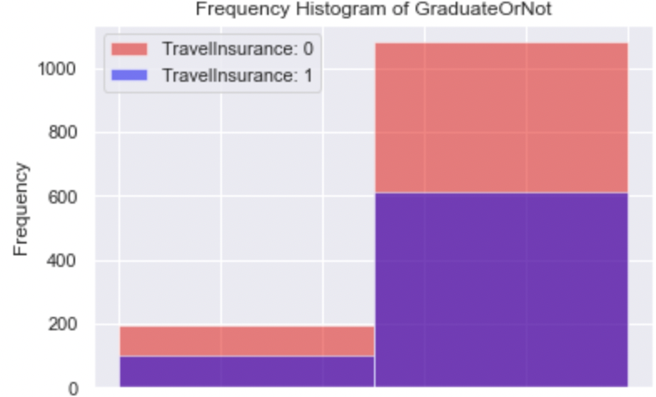
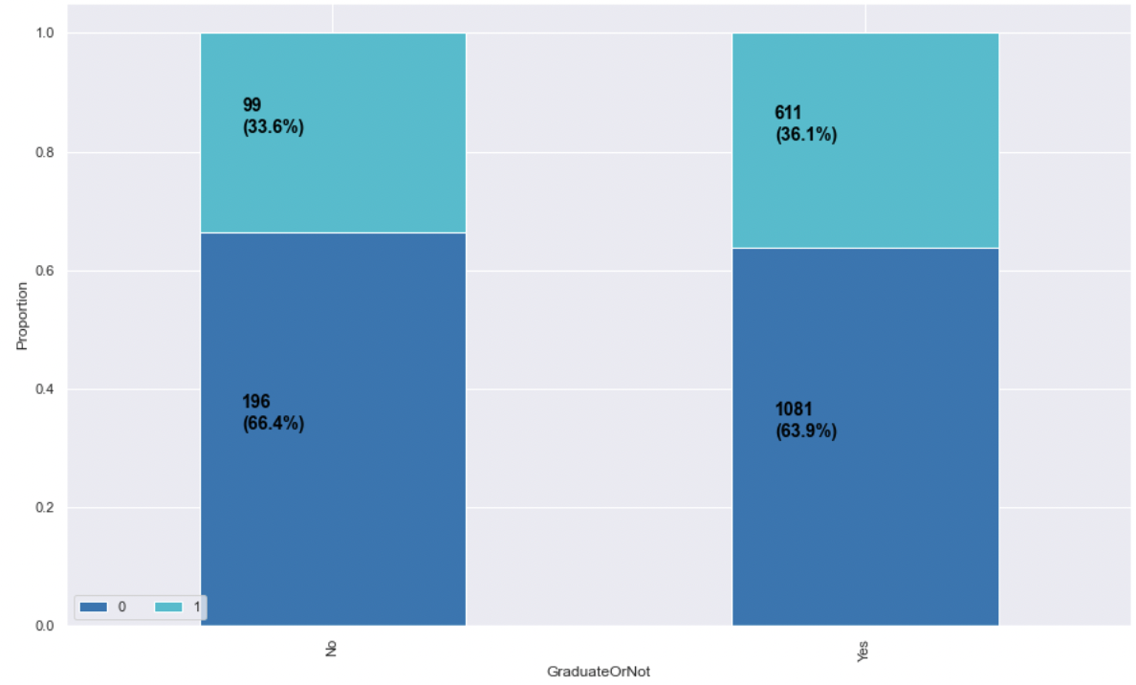
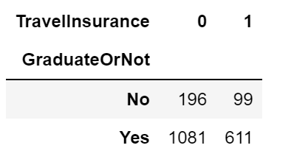
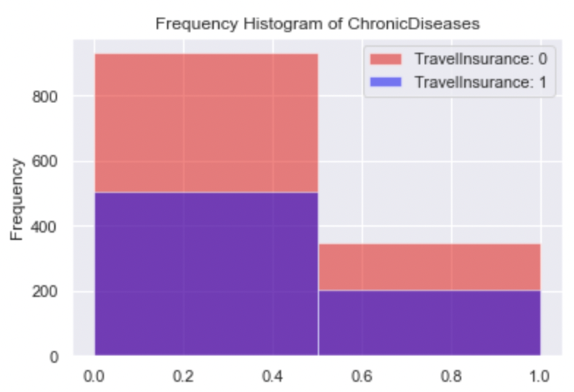
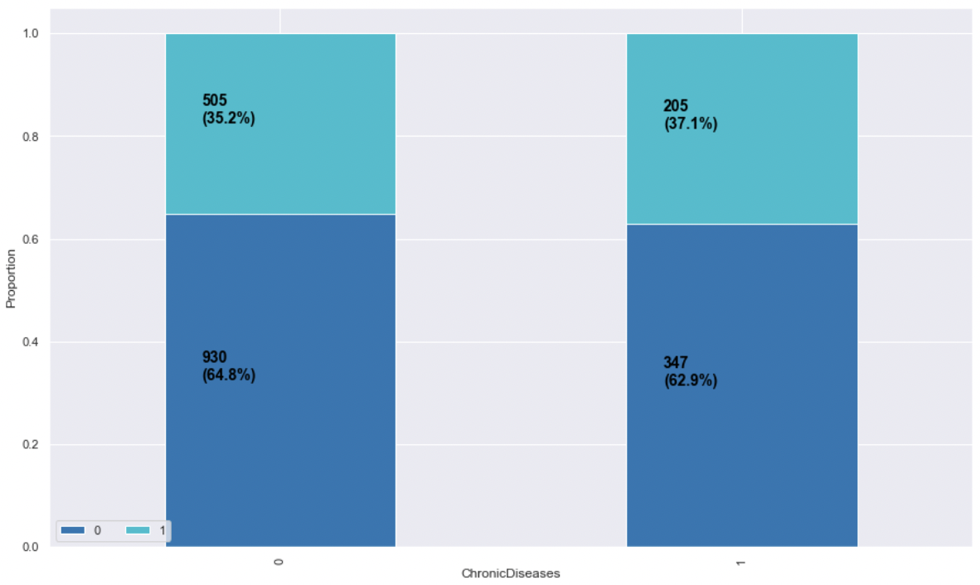
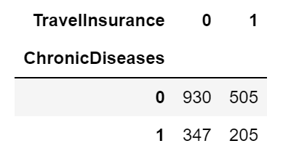
Data Visualization
Project Introduction
Data Overview
Variable Selection
Models
Conclusion
Future
Research
6
Graduate Or Not
Chronic Disease

Slide 15
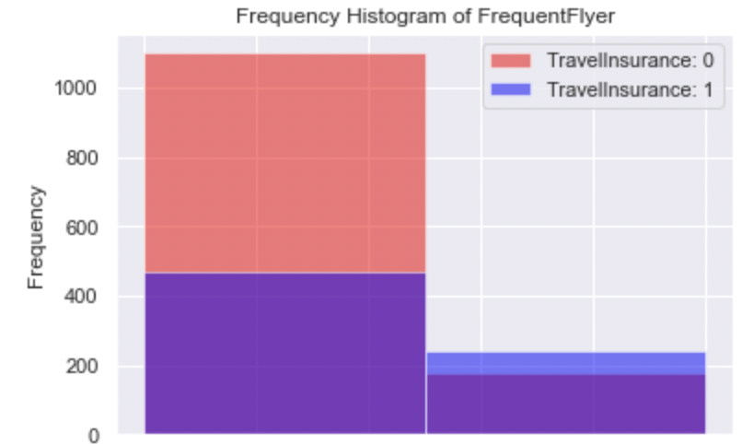
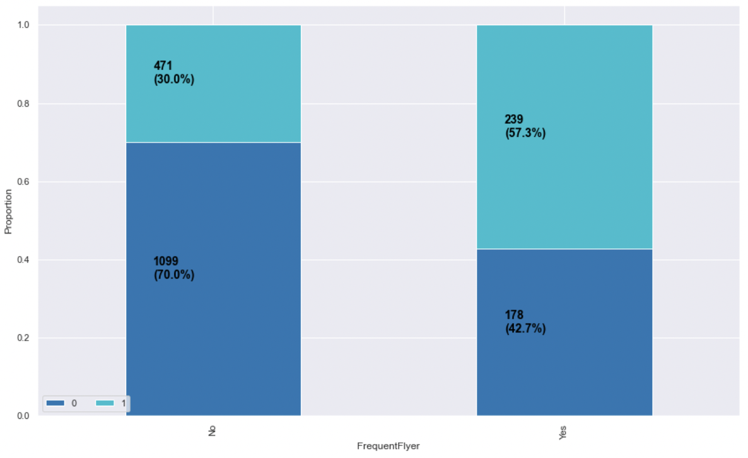
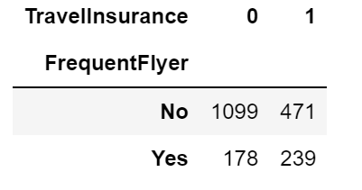
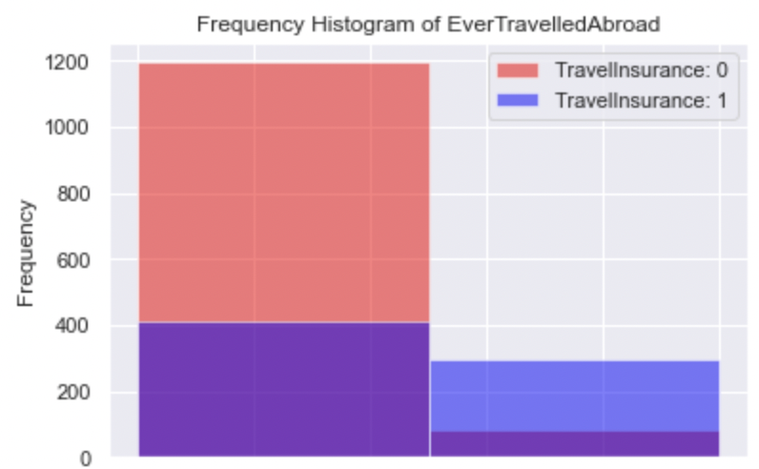
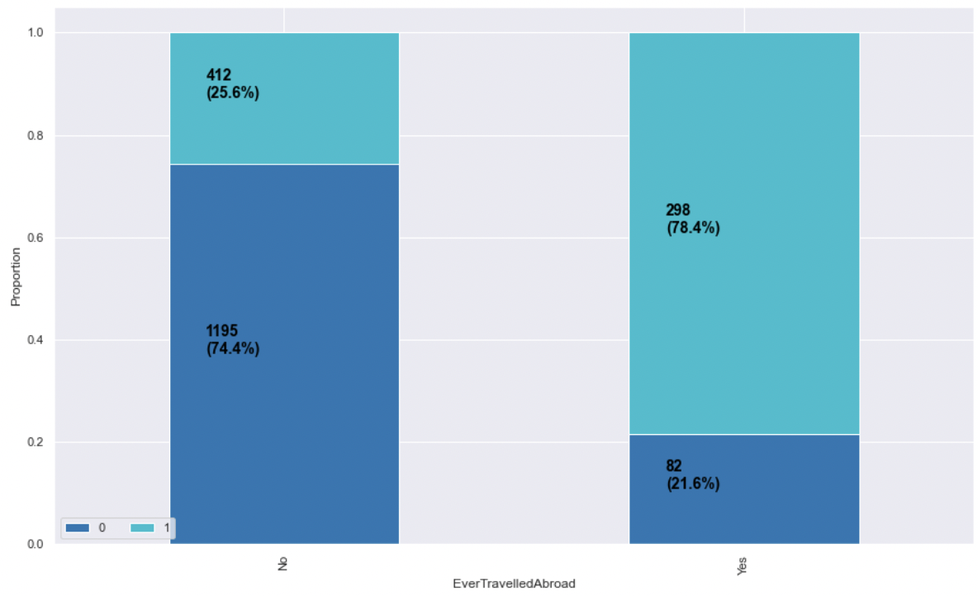
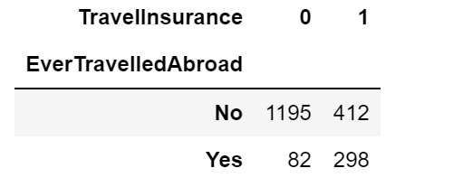
Data Visualization
Project Introduction
Data Overview
Variable Selection
Models
Conclusion
Future
Research
7
Frequent Flyer
Ever Travelled Abroad

Slide 16
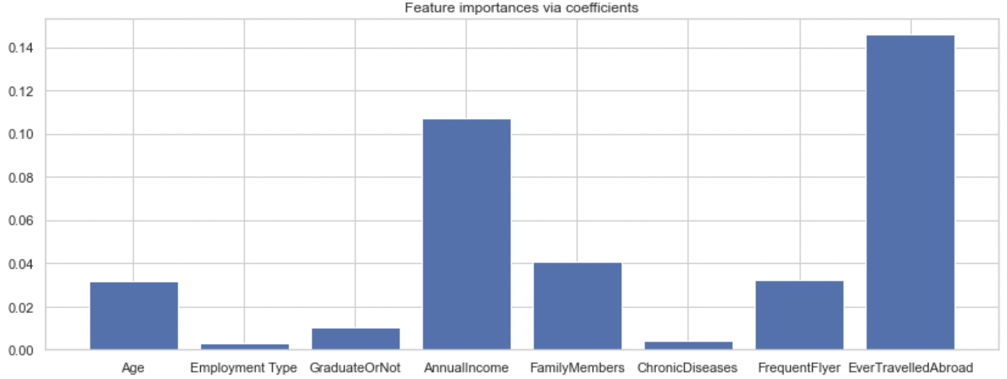
Feature Selection
Project Introduction
Data Overview
Variable Selection
Models
Conclusion
Future
Research
8
Ever Travelled Abroad and Annual Income are the most important predictors, followed by Family Members, Age and Frequent Flyer.
Graduate Or Not, Employment Type and Chronic Diseases seem to be insignificant.
Notes:
We would like to see whether all 8 predictors are necessary and useful in predicting our target variable. To accomplish this, we used the LassoCV function. Trying to minimize the cost function, Lasso regression will automatically select those features that are useful, discarding the useless or redundant features. Based on the result, EverTravelledAbroad and AnnualIncome are the most important predictors, followed by FamilyMembers, Age and FrequentFlyer. GradueteOrNot, Employment.Type and ChronicDiseases seem to be insignificant in this case. In the next step, we will first try to fit our models with all 8 predictors, then the top 5 important predictors and top 3 important predictors and see how the results change.

Slide 17
Models
Logistic Regression
Project Introduction
Data Overview
Variable Selection
Models
Conclusion
Future
Research
9
All predictors
Test Accuracy : 76.63%
(EverTravelledAbroad, AnnualIncome,
FamilyMembers,
Age,
FrequentFlyer,
Graduate Or Not,
Employment type,
Chronic Diseases)
5 predictors
Test Accuracy : 77.14%
(EverTravelledAbroad, AnnualIncome, FamilyMembers,
Age,
FrequentFlyer.)
3 predictors
Test Accuracy : 76.38%
(EverTravelledAbroad, AnnualIncome, FamilyMembers)
Notes:
Logistic Regression
We first performed logistic regression using the function from the sklearn package. Using all 8 predictors, the prediction accuracy on the test set is 76.63%. Using the top five and top three predictors, the accuracy on the test set is 77.14% and 76.38%, respectively. Since including more predictors does not lead to a significant increase in prediction accuracy, if we were to use the logistic regression model, we would prefer the one with three predictors: EverTravelledAbroad, AnnualIncome and FamilyMembers.

Slide 18
Agenda
Project Introduction
Data Overview
Variable Selection
Models
Conclusion
Future research
Q&A

Slide 19
Project Introduction
Project Introduction
Data Overview
Variable Selection
Models
Conclusion
Future
Research
1
Travel insurance reimburses policy holders for:
lost baggage
flight delays
medical problems
Real dataset and business problem from a tour & travels company in India

Slide 20
Data Overview
Project Introduction
Data Overview
Variable Selection
Models
Conclusion
Future
Research
2
Total: 1987 observations
Target
Travel Insurance | 1 if the customer purchased travel insurance package in 2019, and 0 otherwise
Age | Age of the customer
Employment Type | The sector in which customer is employed
Graduate Or Not | Whether the customer is college graduate or not
Annual Income | Annual income of the customer in Indian Rupees (rounded to nearest 50 thousand Rupees)
Family Members | Number of members in customer’s family
Chronic Disease | 1 if the customer suffers from major disease or conditions like diabetes, high blood pressures, asthma, etc, and 0 otherwise
Frequent Flyer | Whether the customer booked at least 4 flight tickets in the past two years (2017-2019)
Ever Travelled Abroad | Whether the customer has travelled to a foreign country
Predictors

Slide 21
Data Visualization
Project Introduction
Data Overview
Variable Selection
Models
Conclusion
Future
Research
3
Target: Travel Insurance (TI)
Out of 1987 observations
710 (35.7%) purchased TI
1277 (64.3%) did not purchase TI

Slide 22
Data Visualization
Project Introduction
Data Overview
Variable Selection
Models
Conclusion
Future
Research
4
Age
Employment Type

Slide 23
Data Visualization
Project Introduction
Data Overview
Variable Selection
Models
Conclusion
Future
Research
5
Annual Income (in Rupees)
Range:
[300,000, 1,800,000]
Family Members

Slide 24
Data Visualization
Project Introduction
Data Overview
Variable Selection
Models
Conclusion
Future
Research
6
Graduate Or Not
Chronic Disease

Slide 25
Data Visualization
Project Introduction
Data Overview
Variable Selection
Models
Conclusion
Future
Research
7
Frequent Flyer
Ever Travelled Abroad

Slide 26
Feature Selection
Project Introduction
Data Overview
Variable Selection
Models
Conclusion
Future
Research
8
Ever Travelled Abroad and Annual Income are the most important predictors, followed by Family Members, Age and Frequent Flyer.
Graduate Or Not, Employment Type and Chronic Diseases seem to be insignificant.
Notes:
We would like to see whether all 8 predictors are necessary and useful in predicting our target variable. To accomplish this, we used the LassoCV function. Trying to minimize the cost function, Lasso regression will automatically select those features that are useful, discarding the useless or redundant features. Based on the result, EverTravelledAbroad and AnnualIncome are the most important predictors, followed by FamilyMembers, Age and FrequentFlyer. GradueteOrNot, Employment.Type and ChronicDiseases seem to be insignificant in this case. In the next step, we will first try to fit our models with all 8 predictors, then the top 5 important predictors and top 3 important predictors and see how the results change.

Slide 27
Models
Logistic Regression
Project Introduction
Data Overview
Variable Selection
Models
Conclusion
Future
Research
9
All predictors
Test Accuracy : 76.63%
(EverTravelledAbroad, AnnualIncome,
FamilyMembers,
Age,
FrequentFlyer,
Graduate Or Not,
Employment type,
Chronic Diseases)
5 predictors
Test Accuracy : 77.14%
(EverTravelledAbroad, AnnualIncome, FamilyMembers,
Age,
FrequentFlyer.)
3 predictors
Test Accuracy : 76.38%
(EverTravelledAbroad, AnnualIncome, FamilyMembers)
Notes:
Logistic Regression
We first performed logistic regression using the function from the sklearn package. Using all 8 predictors, the prediction accuracy on the test set is 76.63%. Using the top five and top three predictors, the accuracy on the test set is 77.14% and 76.38%, respectively. Since including more predictors does not lead to a significant increase in prediction accuracy, if we were to use the logistic regression model, we would prefer the one with three predictors: EverTravelledAbroad, AnnualIncome and FamilyMembers.

Slide 28
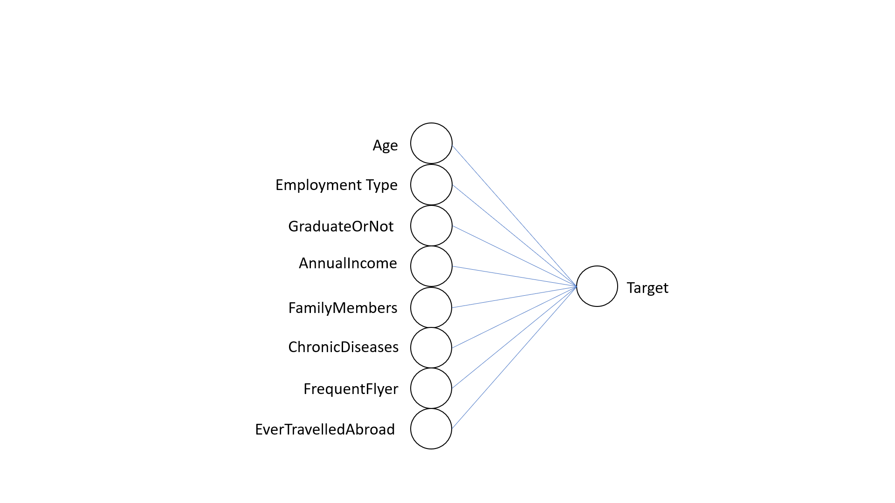
Logistic Regression-Neural network model
Project Introduction
Data Overview
Variable Selection
Models
Conclusion
Future
Research
10
Learning rate:10%
Initial weight:0.01
Initial bias:0.00
Sigmoid activation function
Notes:
Neural Network Model
This is the model of our simple neural network with no hidden layers to estimate target variable.
Since we apply the sigmoid activation function, this model has same equation as logistic regression. The learning rate is 10% Initial weight is 1%. Initial bias is 0.

Slide 29
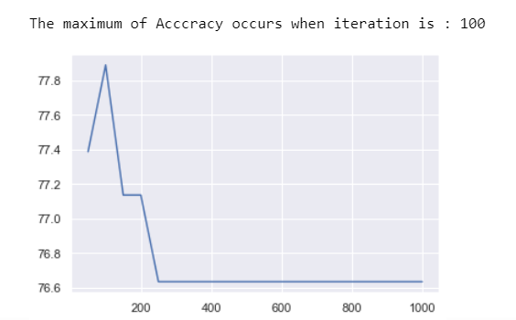
Logistic Regression-Neural network
Project Introduction
Data Overview
Variable Selection
Models
Conclusion
Future
Research
11
Neural network model runs 100 iteration can get the highest accuracy
Notes:
And we try to find the iteration that can produce the maximum accuracy. It turns out that 100 times can train the model the best.

Slide 30
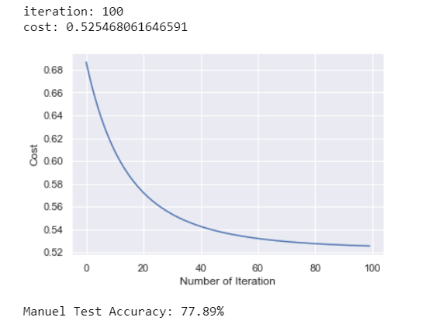
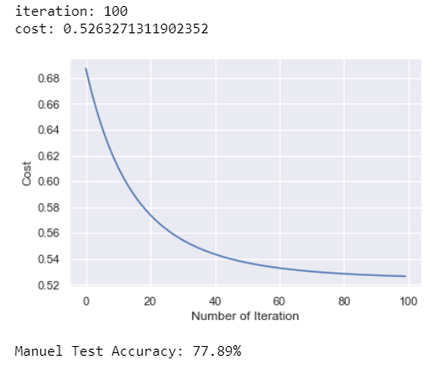
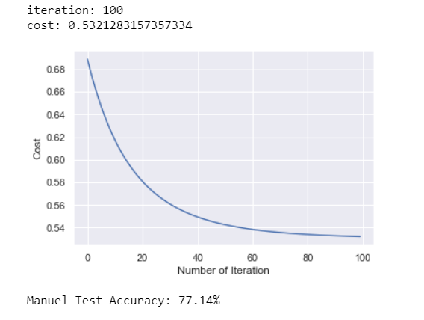
Logistic Regression-Neural network
Project Introduction
Data Overview
Variable Selection
Models
Conclusion
Future
Research
12
All predictors
Test Accuracy : 77.89%
5 predictors
Test Accuracy : 77.89%
3 predictors
Test Accuracy : 77.14%
Notes:
Neural Network
We applied gradient descent to find the optimal weights by iteratively minimizing the cost function(binary cross entropy). Setting the learning rate at 0.1 and the iteration at 100, the resulting prediction accuracy on the test set with all predictors is 77.89%. With five predictors, the accuracy remained at 77.89%, confirming that GraduateOrNot, Employment.Type and ChronicDiseases have little impact. With three predictors, the test accuracy is 77.14%. Again, we prefer the model with three predictors, since the accuracy does not suffer significantly, while the interpretability of the model increases.

Slide 31
KNN (K=2)
Project Introduction
Data Overview
Variable Selection
Models
Conclusion
Future
Research
13
All predictors
2 NN Score: 78.89%
5 predictors
2 NN Score: 77.64%
3 predictors
2 NN Score: 77.14%
Notes:
KNN
Using the KNeighborsClassifier function from the sklearn package with k=2, the test accuracy using eight, five and three predictors is 78.89%, 77.64%, and 77.14%, respectively.

Slide 32
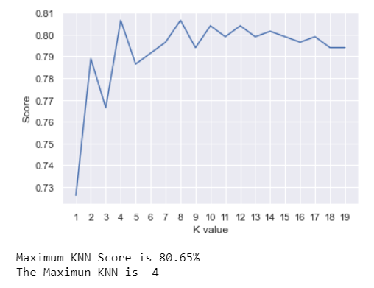
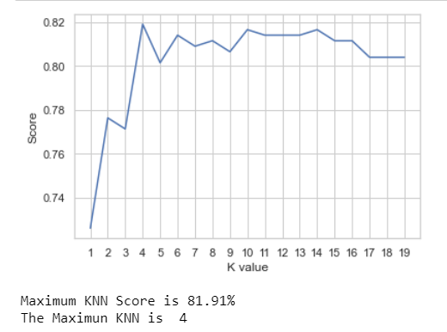
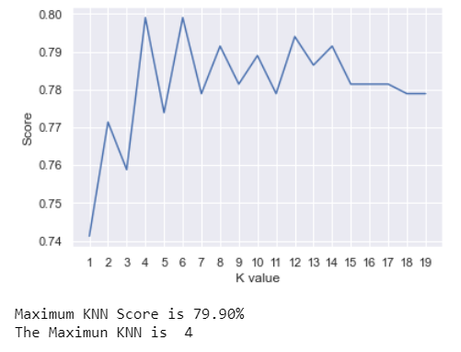
KNN-finding best K
Project Introduction
Data Overview
Variable Selection
Models
Conclusion
Future
Research
14
All predictors
1.K=4
2.KNN Score is 80.65%
5 predictors
1.K=4
2.KNN Score is 81.91%
3 predictors
1.K=4
2.KNN Score is 79.90%
Notes:
KNN
In order to enhance the performance of our model, we try to find the optimal k value by plotting the k values from 1 to 19 and corresponding accuracy measures. The optimal k value that results in the highest accuracy is k=4. Then the improved test accuracy using eight, five, and three predictors is 80.65%, 81.91%, and 79.90%, respectively.

Slide 33
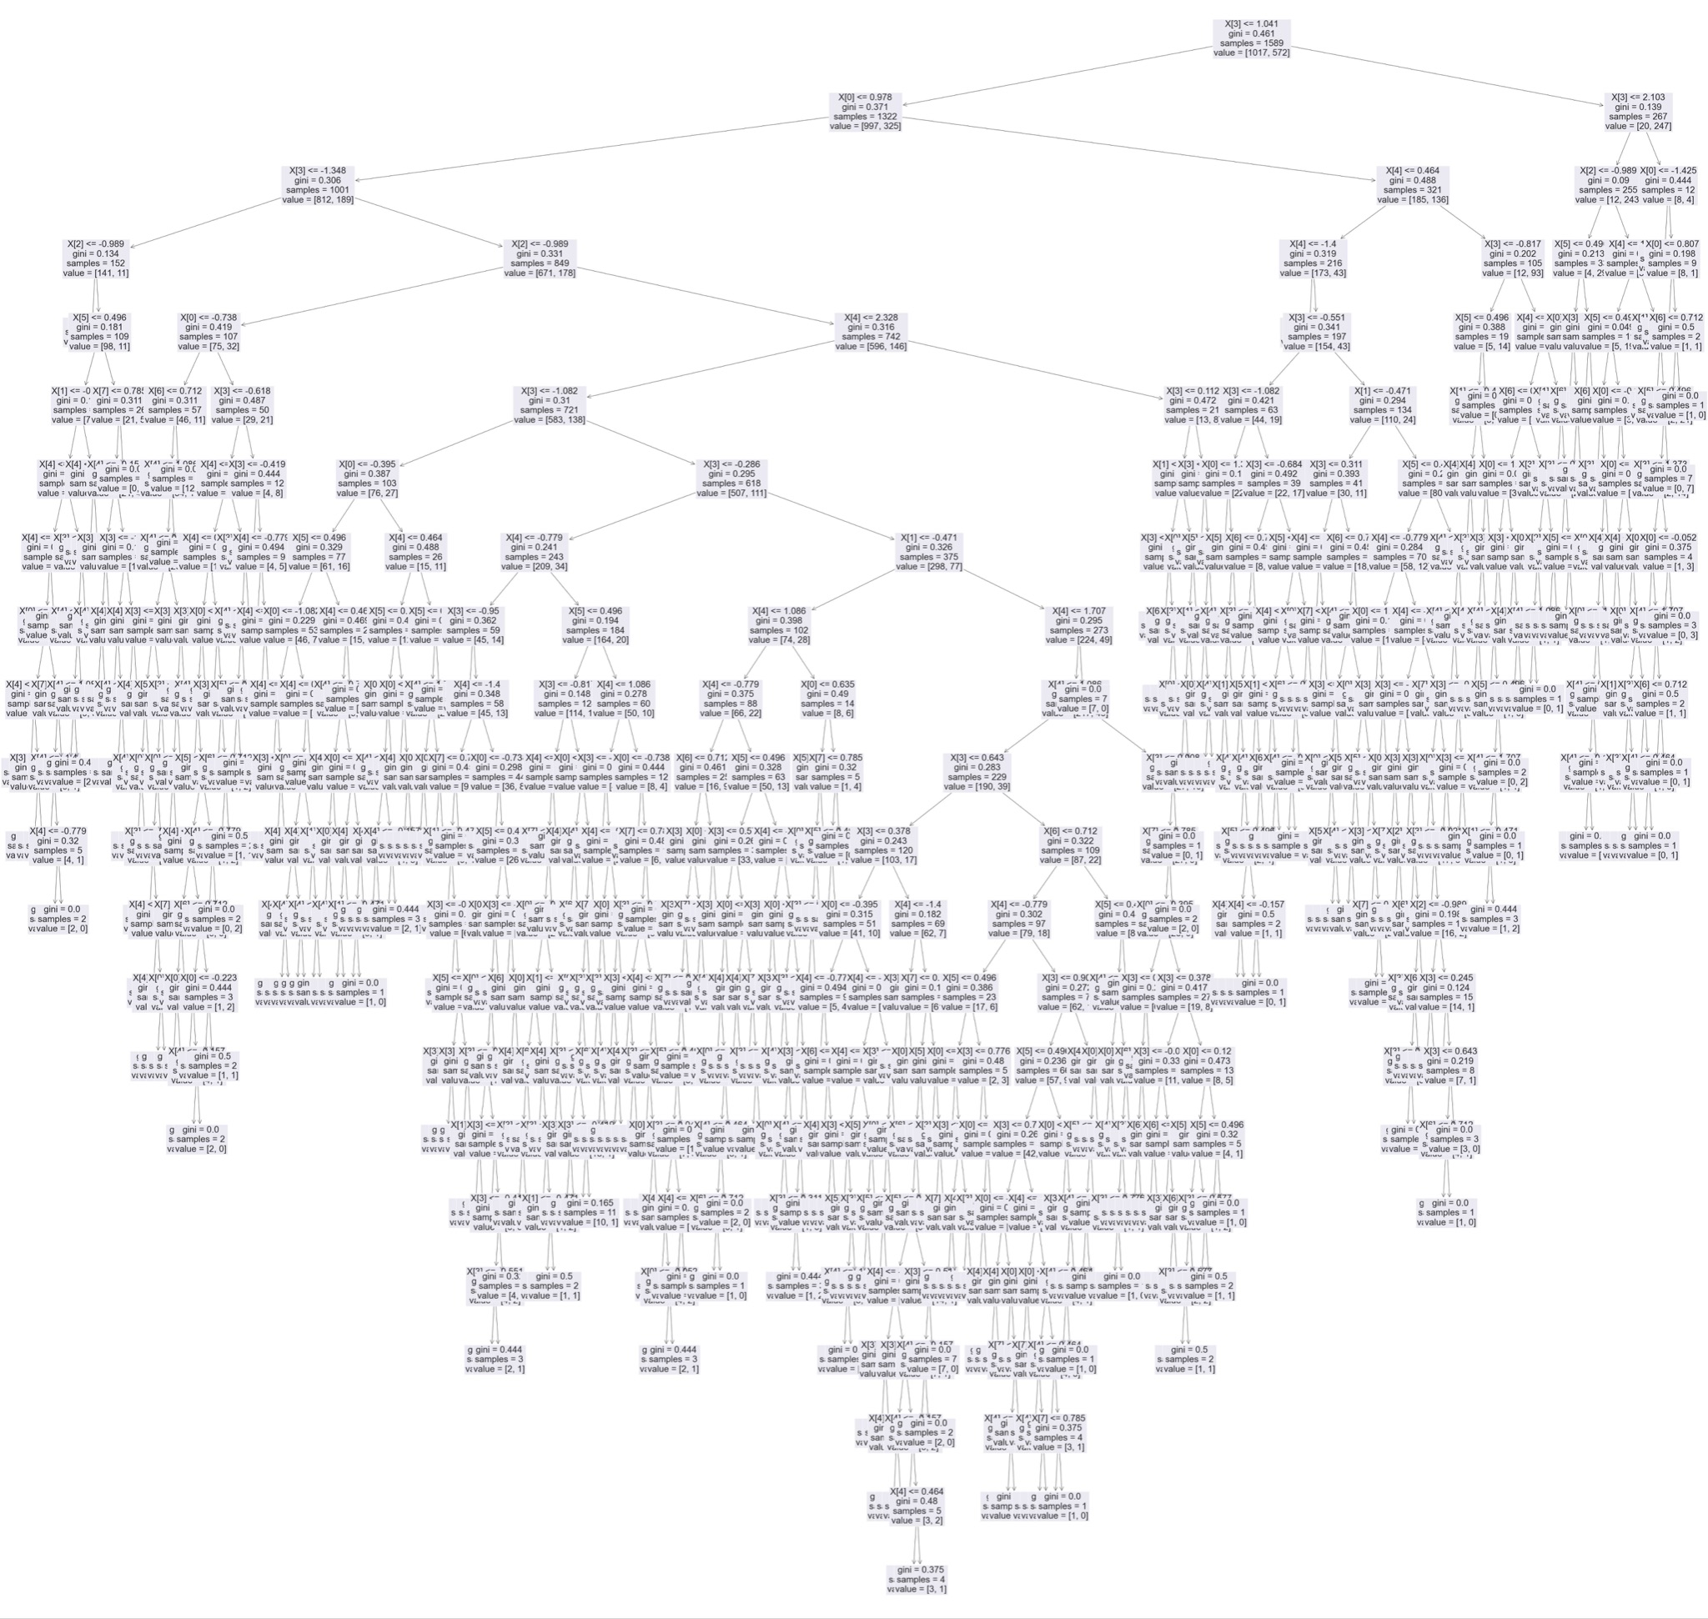
Decision Tree
Project Introduction
Data Overview
Variable Selection
Models
Conclusion
Future
Research
15
• Recursive binary splitting process that splits data into a finite set of non-overlapping regions.
• Pro: easy to interpret and display; no probability distribution assumption
• Con: vulnerable to overfitting.
• All predictors: 76.63%, five predictors: 76.13%, three predictors: 78.39%.

Slide 34
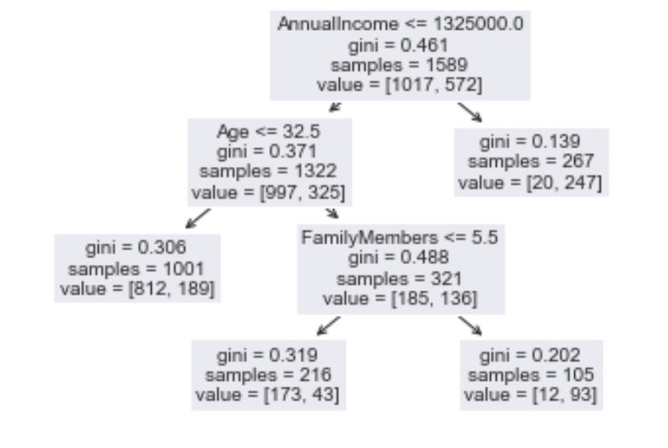
Pruned Decision Tree
Project Introduction
Data Overview
Variable Selection
Models
Conclusion
Future
Research
16
• Pruning is necessary to reduce the size of a tree and remove less valuable splits.
• Pro: reduces overfitting and can lead to a simpler, more interpretable tree; automatically performs variable selection.
• All predictors and five predictors: pruned tree has three predictors with 82.16% accuracy.
• Three predictors: pruned tree has two predictors with 80.4% accuracy.

Slide 35
Bagging
Project Introduction
Data Overview
Variable Selection
Models
Conclusion
Future
Research
17
• Combines the results of a set of decision trees fitted to a different bootstrapped sample of the training data, then using the average to make a final prediction.
• Pro: reduces overfitting and variance of the base tree, leading to higher prediction accuracy.
• Con: loses the interpretability of decision trees and is computationally intensive.
• All predictors: 79.15%, five predictors: 80.65%, three predictors: 77.64%.

Slide 36
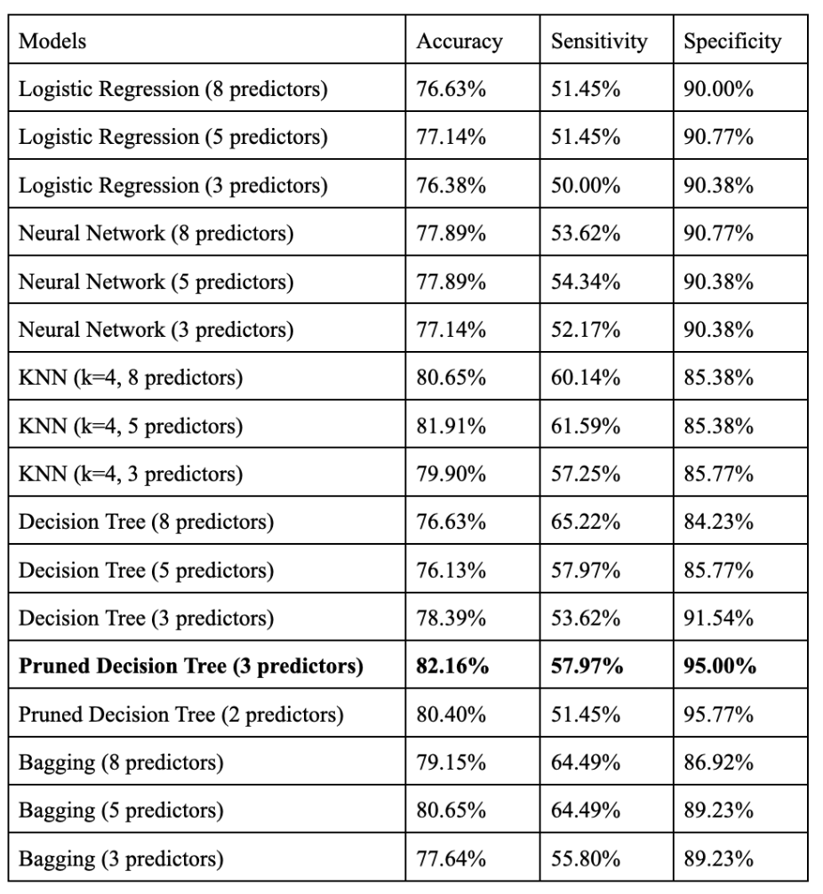
Model Comparison & Observations
Project Introduction
Data Overview
Variable Selection
Models
Conclusion
Future
Research
18
• Models with 5 predictors result in the best performance out of the three
• Low sensitivity and high specificity due to imbalance data

Slide 37
Final Model
Project Introduction
Data Overview
Variable Selection
Models
Conclusion
Future
Research
19
• Pruned decision trees with three predictors: Annual Income, Age, and Family Members.
• Highest test accuracy out of all models: 82.16%.
• Simplest model to explain to a general audience.

Slide 38
Conclusion
Project Introduction
Data Overview
Variable Selection
Models
Conclusion
Future
Research
20
• Check dataset is complete and usable
• Split dataset into training and testing with the ratio 8:2
• Fit different models using training set with different subsets of predictors
• Find the best model based on test accuracy and interpretability

Slide 39
Future Research
Project Introduction
Data Overview
Variable Selection
Models
Conclusion
Future
Research
21
• Sampling techniques to address imbalance data
• Other target of interest
• Other potential predictors (Distance, Duration, Reason, Timing, Mode, Region)
• Other possible models (Elastic Net Model, Boosting, Support Vector Machines)

Slide 40

Thank you !

